Slide 1
sURREALISM
Art 2

Slide 2
Overview
Movement was created by Poet Andre Breton in 1924
Major Players included…
Max Ernst
Joan Miro
Salvador Dali
Rene Magritte

Slide 3
Salvador dali

Slide 4
The accommodations of desire 1929

Slide 5
The enigma of desire, Mother

Slide 6
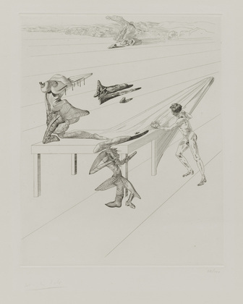

Slide 7
Biography of Salvador dali

Slide 8
Rene Magritte
Notes:
René Magritte was born at Lessines, in the Hainaut, on November 21, 1898. The oldest of three children, his childhood was marked by many moves of family abode, the financial woe due to commercial setbacks of his father and, above all, the dramatic death of his mother in 1912 who drowned herself in the river Sambre.

Slide 9
This is not a pipe

Slide 10
Glocanda (mine of wealth)

Slide 11
The Empire of light 2

Slide 12
The palace curtains 3

Slide 13
The portrait

Slide 14
The false mirror

Slide 18
YOUR CHALLENGE
CREATE AN ORIGINAL AND DYNAMIC COMPOSITION THAT REFLECTS THE SURREALIST ART MOVEMENT

Slide 19
DYNAMIC COMPOSITIONS

Slide 20
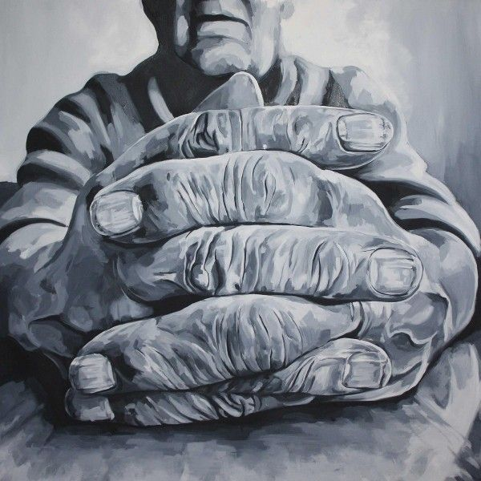

Slide 21
