Slide 1
Space
Art 1 and 2

Slide 2
Vocabulary
Picture Plane
Foreground, Middle ground, and background
overlapping
high and low placement
aerial perspective

Slide 3
Space in 3D Art
Sculptors consider positive and negative spaces to create interesting relationships
Barbara Hepworth, Pendour.
Notes:
Sculpture is designed and created to be seen from all angles, or in the round. Artists want to simulate movement or visual movement. They lead your eye around the sculpture with curved or diagonal lines.
The holes or space in Hepworth’s sculptures are just as import as the material or mass. Agree or Disagree?

Slide 4
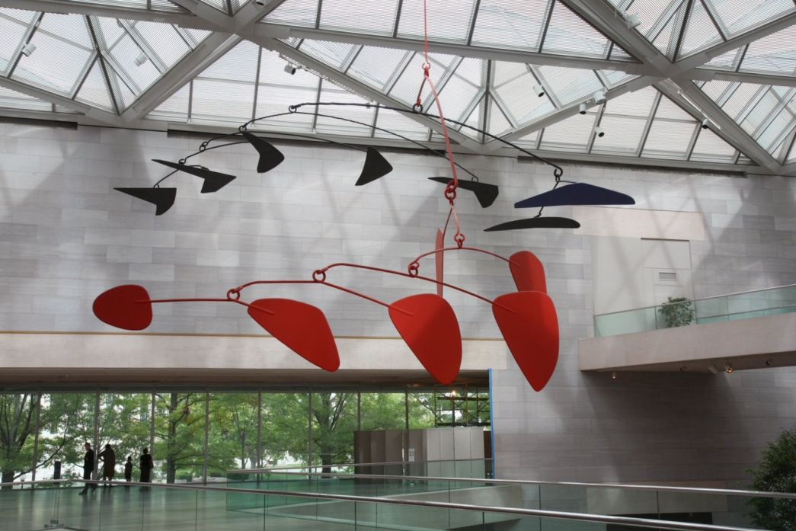
Space in 3D Art
3D works that move are called Kinetic Art
Alexander Calder, Mobiles
Notes:
Alexander Calder created the Mobile in bottom left just before his death in 1976. At first he planned to add small motors to the sculpture so it would move but after measuring the air currents, he found there is enough! It will move!

Slide 5
Space in 3D Public Art
Notes:
1995- truck with explosives blew up the Alfred P. Murrah Federal Building. 168 innocent people, including 19 children in a daycare center, died.
Designing for a memorial carries a lot of weight. The memorial needs to meet the needs of survivors, victim’s families, city planners, local business and the public.

Slide 6
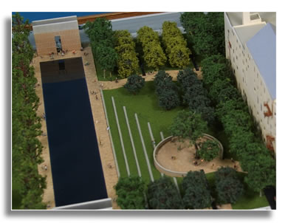
Space in 3D Public Art
Oklahoma City National Memorial, by Butzer Design Partnership.
Notes:
Memorial consists of two gates, one displaying the time 9:01 the moment before the explosion, and the other 9:03 the moment the city was changed forever.

Slide 7
Space in 3D Public Art

Slide 8
Space in 3D Public Art
Notes:
There are 168 empty chairs representing each individual lost. They are arranged in 9 rows representing the 9 floors on which the victims worked or visited

Slide 9
Space in 3D Public Art
Photo by Eric D Brown
Notes:
The memorial wanted to emphasize place, a moment in time, and the passage of time. How have they achieved this goal?
How does the design and use of space help achieve this? Or achieve an emotional response?

Slide 10
Space in 2D Art
The flat surface of a painting = The Picture Plane
Space in 2D art can refer to the background, unfilled areas of picture plane.
Notes:
Kathe Kollowitz Self Portrait 1924
In 2D art, Space doesn’t always refer the illusion of space (making it look 3D) it can describe how the artist organizes the space on the picture plane.

Slide 11
Space in 2D Art
Space doesn’t always refer the illusion of space (making it look 3D) it can describe how the artist organizes the space on the picture plane.
Notes:
Kathe Kollowitz Self Portrait 1924

Slide 12
Techniques to Create a Sense of Depth
Overlapping
High and Low Placement
Linear Perspective
Aerial Perspective

Slide 13
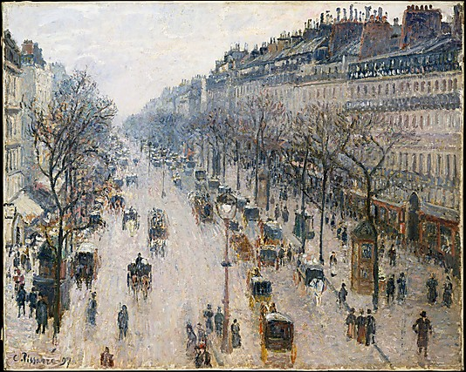
Overlapping

Slide 14
High and Low Placement

Slide 15
Aerial Perspective

Slide 16
Aerial Perspective

Slide 17
Foreground, Middle Ground, and Background

Slide 18
Caleb Bingham
Can you find examples of overlapping high and low placement and aerial perspective in this work?

Slide 19
Caleb Bingham
What are the positive and negative shapes in Bingham's painting?

Slide 20
Weekly Sketch
Create an imaginary place with something in the foreground, middle ground, and background.
Use overlapping and high and low placement to indicate space.
Vary the Intensities that you use for the foreground and background.

