Slide 1
Shape
Pablo Picasso
Edward Hopper
Art 3/4

Slide 2
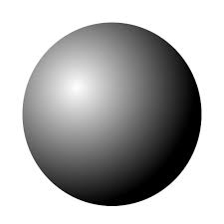
Shape
Form
2 Dimensional area with a recognizable boundary
3 Dimensional shape

Slide 3
Figure Ground
Figure is the object
Ground is the background
Sometimes it is hard to distinguish

Slide 4
Positive and Negative Shape
Positive Shape
Term used to describe the figure or subject
Term used to describe the background
Negative Shape

Slide 5
Organic and Geometric Shapes

Slide 6
Open and Closed Shapes
Open Shapes have space around and between them and share some importance with the background
Closed shapes and forms seem solid and heavy

Slide 7
Pablo Picasso
Son of an academic painter
Picasso started drawing at a young age
Born 1881- died 1973

Slide 8
Pablo Picasso
He often included a person in a harlequin suit in his artworks as a symbol of himself.
Traditionally the harlequin figure was a clown or buffoon in Italian pantomimes (stories told with facial expressions and body movement)

Slide 9
Pablo Picasso
The Three Musicians
Where do you see shapes repeated?
Which shapes do you notice first?

Slide 10
Pablo Picasso
The Three Musicians
How do the shapes
create a mood? A sense of whimsy?
What kind of music do they make?

Slide 11
Shape Constancy
The tendency to see a shape as unchanging regardless of the angle at which you see it.

Slide 12
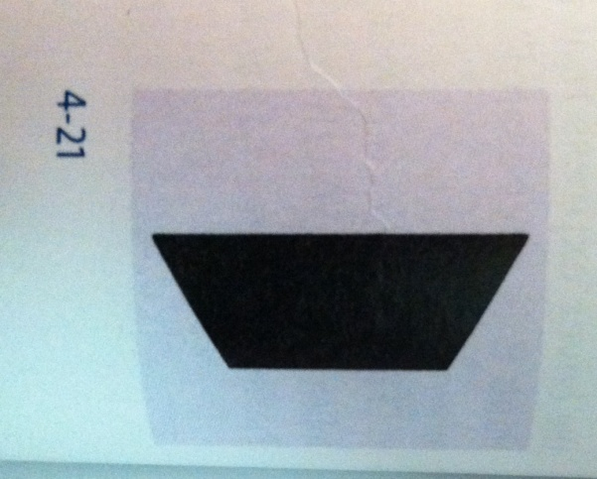
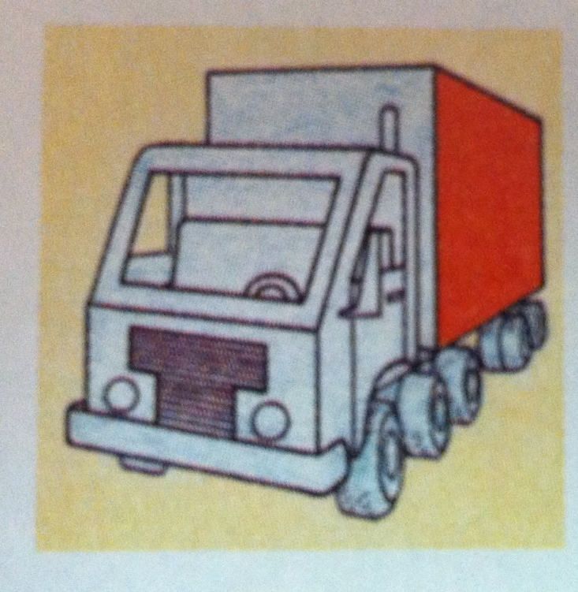
Foreshortening
Making a 3 dimensional object in a picture seem to recede in space by shortening the depth dimension

Slide 13
Foreshortening in Action
Andrea Mategna, Dead Christ

Slide 14
Edward Hopper
Painted scenes of ordinary American architecture
All night cafes
Main street storefronts
Movie theaters

Slide 15
Edward Hopper
He lit his subjects harshly with strong shadows to create a feeling of isolation

Slide 16
Edward Hopper
What shapes does Hopper primarily use in this work?
Is there any sense of a human presence?

Slide 17
Weekly Sketch
Draw a building or park that represents something you would like to see built in your community
Use geometric, organic, decorative and functional shapes in your design.

