Slide 1
The Mysterious Mayan Culture
Art 2

Slide 2
Mayan Territory

Slide 3
Mayan Culture Today
Lots of Turmoil and Destruction but much remains
Weaving Craft
Manner of Dress
Traditional Crops
Rituals

Slide 4
Turmoil and Destruction
Spanish Missionaries 1500s
Burned Books
Destroyed Art
Enslaved Mayans
Disrupted Rituals
Notes:
Books are records of rituals, songs, legends, and calendar notations. Books were written and painted on long folded bark thinly coated with line stucco.
Bishop Landa headed the missionaries in the Yucatan Penninsala. Only 4 books, known as codices, remain. They are now named after the 4 cities they live in: Madrid, Paris, Dresden, and Grolier (Mexico City). Bishop kept his own records which now survive and serve as record of the historic clash between Spanish and Pre-Columbian worlds.

Slide 5
Turmoil and Destruction
Spanish arrived to a broken Mayan Civilization
Great architecture centers were abandoned
Small Mayan civilizations spread out and secluded from one another
Mayans could not unite against the Spanish invasion.

Slide 6
Mayan Architecture
Cities made of limestone
Covered with sculpted images of animals and glyphs
When new, they were painted brilliant reds, blues, greens, and yellows

Slide 7
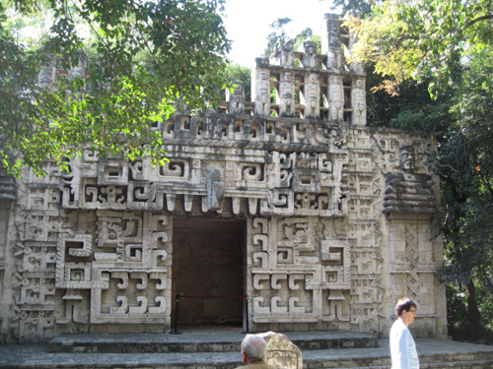
Mayan Architecture
Mayans built pyramids to symbolize sacred Mountains for Priests and kinds to contact otherworld
Notes:
Entry ways were often depicted as the mouth of a monster. Have you seen this used in fantasy films? Cartoons or kids TV shows?

Slide 9
Mayan Architecture
Mayans walked away from their ceremonial centers sometime in the 10th Century
Reasons Unknown

Slide 10
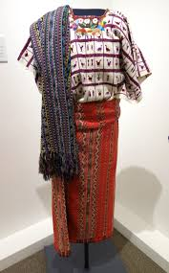
Mayan Weaving
Costume was how they expressed their identity
Mayan women weave and wear garments styles that have been around for centuries.

Slide 11
Mayan Weaving
Ixchel is the goddess of weaving
Garments include symbols and patterns that serve as a timeless connection to their spirits and ancestors
Symbols for rain fertility and growth

Slide 12
Mayan Mystery
Write 2-3 complete sentences speculating why the Mayans abandoned their great ceremonial centers in the tenth century

