Slide 1
Marilyn Levine

Slide 2
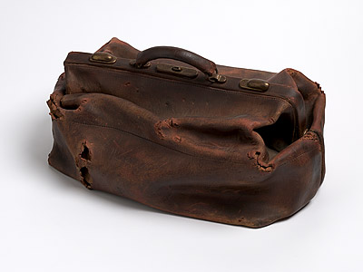
Johnston Satchel, 1975

Slide 3
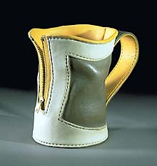
Zipup, 1994

Slide 4
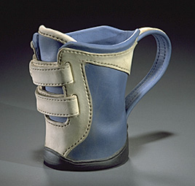
Burr, 1994

Slide 5
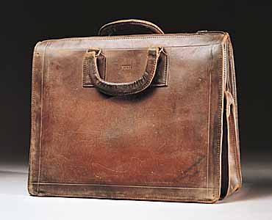
HRH Briefcase, 1985

Slide 6
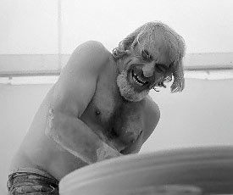
Peter Voulkos
http://www.youtube.com/watch?v=xBsNf6XfqGo
Internet Explorer Only

Slide 7
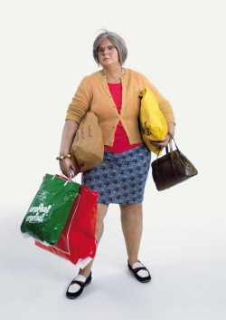
Dwayne Hanson

Slide 8
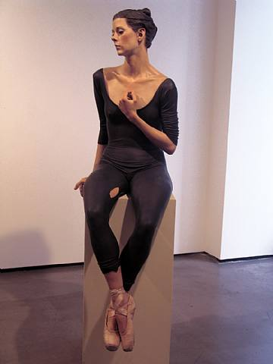
John De Andrea

