Slide 1
Ceramics
Art 1 and 2

Slide 2
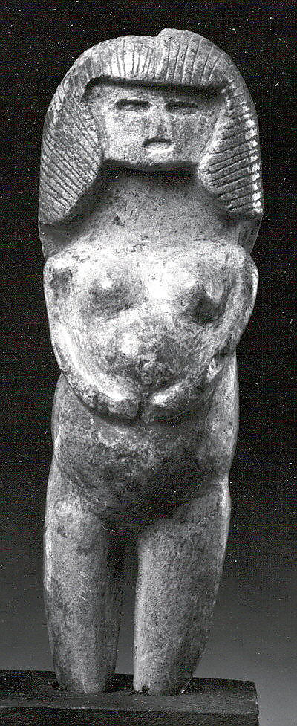
History
2400 BC- Clay discovered
Clay Figurines
Ecuador Figurines
Notes:
Figurines are crafted in clay first of its kind in South America- Ecuador
Clay figures follow their stone figure tradition.
Most of the figures were Female, some had both sexes
Upright body position and clasped hands is similar to some dance poses in Native American Cultures- Scholars believe these figurines may have been sculpted to depict dancing.

Slide 3
History
9000 BC- Functional Vessels first made
Mesopotamia/India
Iron Age Vessels
Middle East
Notes:
IRON AGE (1200 - 550 B.C.E.)
Functional uses for ceramics were found to build structures, and hold food and water.

Slide 4
Histroy
8000 BC Glaze Discovered in Egypt
Notes:
Leave pattern represents where animal lived- in the marshes
Hippos were very dangerous, still are!
This one was part of a pair found in a tomb. Three of its legs were broken to prevent the creature from harming the deceased- Egyptians believed in multiple lives..
This example was one of a pair found in a shaft associated with the tomb chapel of the steward Senbi II at Meir, an Upper Egyptian site about thirty miles south of modern Asyut. Three of its legs have been restored because they were purposely broken to prevent the creature from harming the deceased. The hippo was part of Senbi's burial equipment.

Slide 5
Heather O’Brien

Slide 6
Bonnie Seesman
Today there are Functional and Non Functional Artists

Slide 8
Adrián Villar Rojas

Slide 9
Art 1 and 2 Assignment
Choose a culture or country to research
Metropolitan Museum of Art
Art Institute
Getty Museum

Slide 10
Art 1 Assignment
Choose a symbol or icon from your country to carve into Pinch Pot Cup

Slide 14
Art 2 Assignment
Build a slab Box and embellish with imagery/pattern inspired by your chosen culture

