Slide 1
Romero Britto
A New Day, 2001

Slide 2
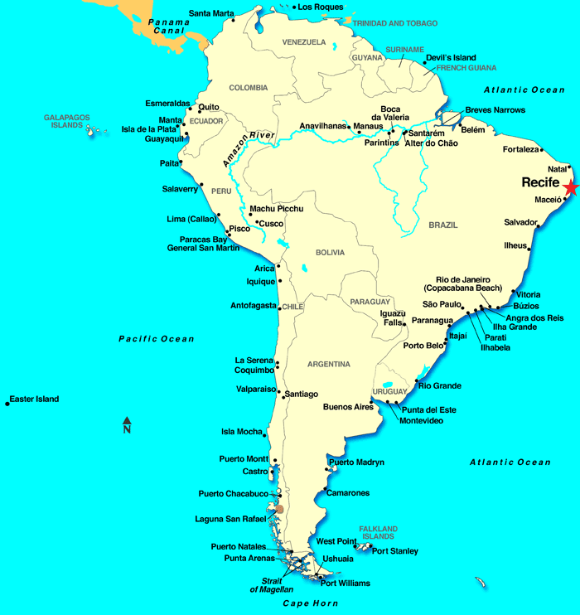
Born in Recife,
Brazil in 1963

Slide 3
5th largest city in Brazil
1.5 Million People
Industries: brewing and canning, automotive electronics, tube manufacturing, chocolate manufacturing, textiles

Slide 4
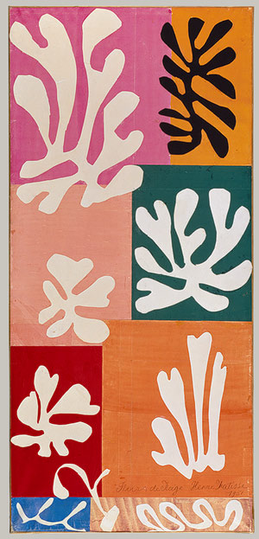
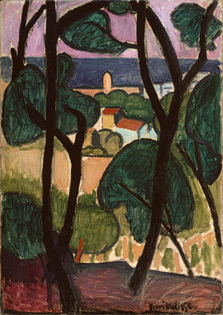
Influences
Henri Matisse, French
1869-1954
View of Collioure and Thesea (above)
Snowflowers (right)

Slide 5
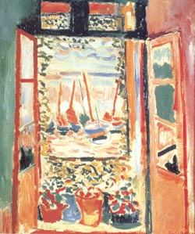
Looking Into the Future 2005
The Open Window

Slide 6
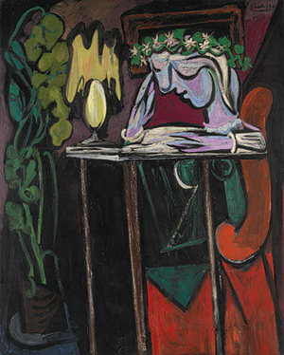
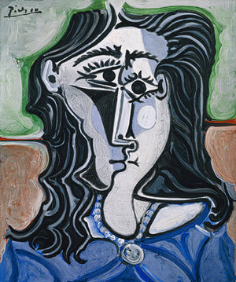
Influences
Pablo Picasso
From Spain
1881-1973
Reading Table (above) Head of a Woman (left)

Slide 7
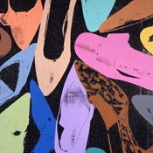
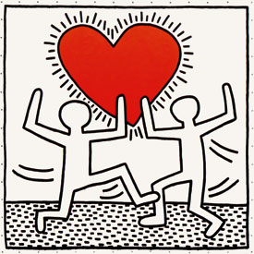
Influences
Pop Art
Andy Warhol
Keith Haring
Warhol, Diamond Dust Shoes (above)
Haring, Heart (left)

Slide 8
Atlantic Family Tree

Slide 9
Angle

Slide 10
The Good Life 1990

Slide 11
Love Blossom 1998

Slide 12
Untitled 2004

Slide 13
Heart Lunch 2006

Slide 14
Its For You 2005

Slide 15
Squeaki Van Britto 2005

