Slide 1
Printmaking
Art 1

Slide 2
Types
RELIEF
Intaglio
Lithography
Silk Screen

Slide 3
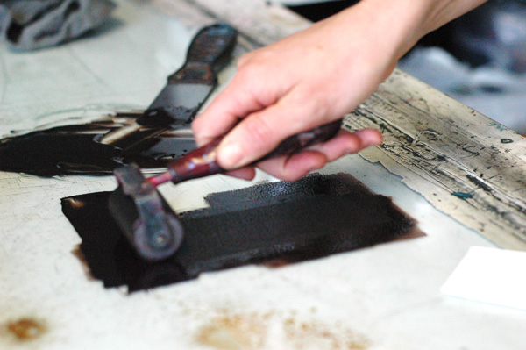
Relief
Plate= surface on which the picture or design is made
Traditionally, plates were wood

Slide 4
Albrecht Durer
1471-1528
-Painter, Draftsman, and Writer
-Dürer revolutionized printmaking
-He expanded the tonal range
-Added Drama
-Provided the imagery with a new conceptual foundation
Notes:
This Rhinoceros was drawn without Durer ever seeing one. He was sent a description and sketches from which he made his final plate.

Slide 5
durer
The Four Horsemen of the Appcalypse
Notes:
Previous illustrations of this passage from the bible were unthreatening
The four horseman stand for Famine, War, Death and Plague.
The diagonal line created by the four horsemen creates movement and drama. Very intricate overlapping
Middle tone/ gray is created by repeated horizontal lines in the background.
Passage:
"And I saw, and behold, a white horse, and its rider had a bow; and a crown was given to him, and he went out conquering and to conquer. When he opened the second seal, I heard the second living creature say, 'Come!' And out came another horse, bright red; its rider was permitted to take peace from the earth, so that men should slay one another; and he was given a great sword. When he opened the third seal, I heard the third living creature say, 'Come!' And I saw, and behold, a black horse, and its rider had a balance in his hand; … When he opened the fourth seal, I heard the voice of the fourth living creature say, 'Come!' And I saw, and behold, a pale horse, and its rider's name was Death, and Hades followed him; and they were given great power over a fourth of the earth; to kill with sword and with famine and with pestilence and by wild beasts of the earth."

Slide 6
dURER
This Rhinoceros was drawn without Durer ever seeing one. He was sent a description and sketches from which he made his final plate.

Slide 7
Katsushika Hokusai
1760-1849
Skilled Printmaker
Famous for his series, 36 Views of Mount Fuji
Notes:
How many colored block were used to print this?
Where must the viewer be to have this viewpoint?
Wave towers over viewer and mountain.
Hokusai is working with a traditional theme, sense of place, in a new way- making it not the main focus but the secondary focal point.
Boats in the foreground show everyday labor.

Slide 8
Hokusai

Slide 9
Hokusai

Slide 10
Emily Trueblood
1942- Present
Notes:
I look for city and nature views that appeal to me. I change and simplify the composition until I feel that I can express it as a woodcut or linocut. In city views, I like the contrast of round water towers next to straight buildings. I am interested in creating a mood or the feeling of certain weather with the colors I use. I add a third or fourth block if I feel it is necessary, but many times I use two blocks. When I begin I often do not know what the final print will look like; I find it challenging to solve problems as I go along. In the proofing stage I draw and paint on a proof until I find the colors I want to use. I often return to the same themes in new prints.
Woodcuts and linocuts enable me to work in a simplified, bold way. Once cut, the blocks are almost impossible to change. I like working like this way because it forces me to focus on what I most want to express.

Slide 11
Trueblood
Notes:
When I begin I often do not know what the final print will look like; I find it challenging to solve problems as I go along. In the proofing stage I draw and paint on a proof until I find the colors I want to use. I often return to the same themes in new prints.
Woodcuts and linocuts enable me to work in a simplified, bold way. Once cut, the blocks are almost impossible to change. I like working like this way because it forces me to focus on what I most want to express.

Slide 12
Order in the courtroom!
Create a logical and convincing argument for your own evaluation of an artwork.

Slide 13
Emily Trueblood

Slide 14
Albrecht durer

Slide 15
Emily Trueblook

Slide 16
Katsushika hokusai

Slide 17
Emily trueblood

Slide 18
Katsushika Hokusai
Notes:
Wave towers over viewer and mountain.
Hokusai is working with a traditional theme, sense of place, in a new way- making it not the main focus but the secondary focal point.
Boats in the foreground show everyday labor.
The preeminence of this print—said to have inspired both Debussy'sLa Mer and Rilke's Der Berg—can be attributed, in addition to its sheer graphic beauty, to the compelling force of the contrast between the wave and the mountain. The turbulent wave seems to tower above the viewer, whereas the tiny stable pyramid of Mount Fuji sits in the distance. The eternal mountain is envisioned in a single moment frozen in time. Hokusai characteristically cast a traditional theme in a novel interpretation. In the traditional meisho-e (scene of a famous place), Mount Fuji was always the focus of the composition. Hokusai inventively inverted this formula and positioned a small Mount Fuji within the midst of a thundering seascape. Foundering among the great waves are three boats thought to be barges conveying fish from the southern islands of Edo. Thus a scene of everyday labor is grafted onto the seascape view of the mountain

