Slide 1
Texture
Art 3 & 4

Slide 2
Vocabulary
Texture
Actual Texture
Simulated Texture
Invented textures

Slide 3
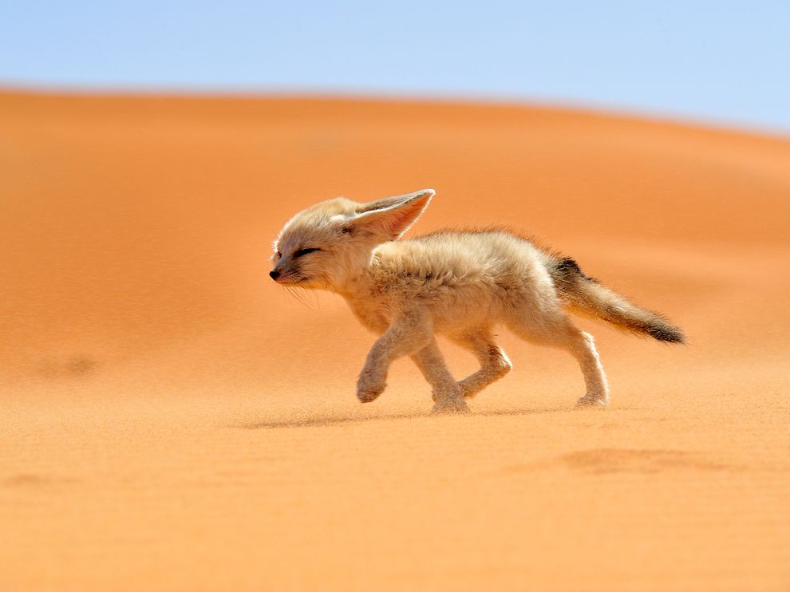
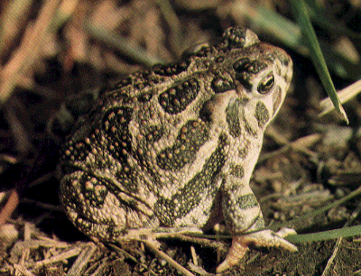
Texture
The way the surface of an object feels
Rough, smooth, grainy, slick, and gritty

Slide 4
Actual Texture
Textures of real objects you can touch
Textures of plants and animals has function
Notes:
The function of frog skin is to regulate moisture and fluid transfer. This is why frogs live near lakes, ponds, and streams. This is also why it is not good to hold a frog for too long. Your dry hands will cause the frog's skin to become dry.
http://cgee.hamline.edu/frogs/science/faq1.html#anatomy

Slide 5
Texture in Art
Simulated : to look like real life
Invented : Textures not intended to resemble textures you find in real life
Michel Sittow, Portrait of Diego de Guevara 1515-1518
Notes:
Michel Sittow, Portrait of Diego de Guevara 1515-1518

Slide 6
Invented Texture

Slide 7
Edouard Manet
Describe the textures in this painting.

Slide 8
Michelangelo
Pieta means pity or compassion
Michelangelo was in his 20s when he created this
The only sculpture he ever signed.
Kahn Academy Analysis
Notes:
Many say Mary looks to young to be Christ's mother in this work. Michelangelo rebutted stating that people aged because they sinned and she was perfect.
A sculptor determines how much his stone is polished. What factors might have led to Michelangelo’s decision to highly polish this piece?
What aspect of the image does the very fine texture help emphasize?

Slide 9
How to Create Texture
A hard, smooth surface is highly reflective.
This creates sharp, crisp edges and stronger contrasts of light and dark values.
Notes:
Light hits more of the surface and bounces off.

Slide 10
How to Create Texture
A soft surface absorbs the light, creating smooth transitions between highlights and shadows.

Slide 11
How to Create Texture
If the surface is rough, the light hits less of the surface or hits it in less or sporadic areas.
The reflected light is less, making softer variances in values.
The rougher the texture, the stronger the variance
Notes:
Rough surfaces like tree bark, have many small ridges that catch the light on the high ridge with a dark shadow behind the ridge, creating stronger variances.

Slide 12
Weekly Sketch
Draw an object with an invented or unnatural texture

