Slide 1
Space
Art 3/4

Slide 2
Vocabulary
Picture Plane
Positive and Negative Space
Framing
Color Variation
overlapping
high and low placement
aerial perspective

Slide 3
Space in 2D Art
Space doesn’t always refer the illusion of space (making it look 3D) it can describe how the artist organizes the space on the picture plane.
Notes:
Kathe Kollowitz Self Portrait 1924

Slide 4
Techniques to Create a Sense of Depth
Overlapping
High and Low Placement
Linear Perspective
Aerial Perspective

Slide 5
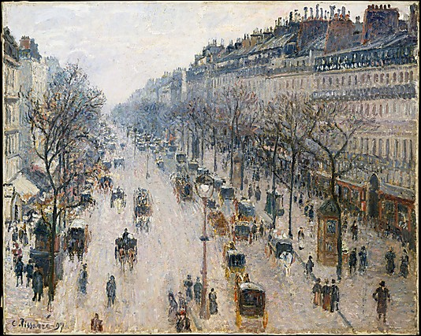
Overlapping

Slide 6
High and Low Placement

Slide 7
Aerial Perspective
Colors closer are more intense

Slide 8
Aerial Perspective
Colors further away are less intense

Slide 9
3D Space in Abstract Art
Overlapping
Color Variation
Which color blocks come forward?
Hans Hofmann, The Golden Wall
Notes:
Warm Colors come forward and Cool Colors Recede

Slide 10
Framing
Winslow Homer, The Country School
Notes:
In Homer’s original- We see entire school room
Teacher is largest = most important
All people are somewhat small in whole room so they are relatively far away.
How does framing the child on the left change the story? Is it more or less interesting?

Slide 11
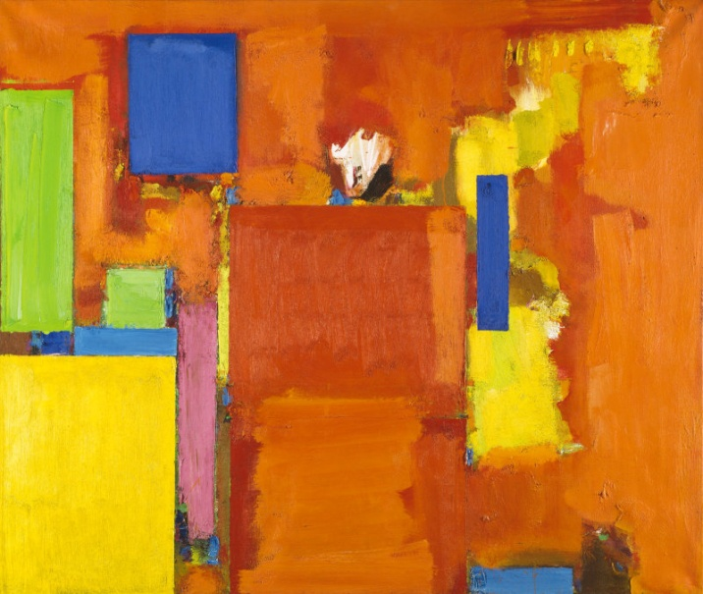
Evaluate
How well do each of these works use:
overlap
high low placement
aerial perspective
color to create depth.

Slide 12
Space in 3D Art
Sculptors consider positive and negative spaces to create interesting relationships
Barbara Hepworth, Pendour.
Notes:
Sculpture is designed and created to be seen from all angles, or in the round. Artists want to simulate movement or visual movement. They lead your eye around the sculpture with curved or diagonal lines.
The holes or space in Hepworth’s sculptures are just as import as the material or mass. Agree or Disagree?

Slide 13
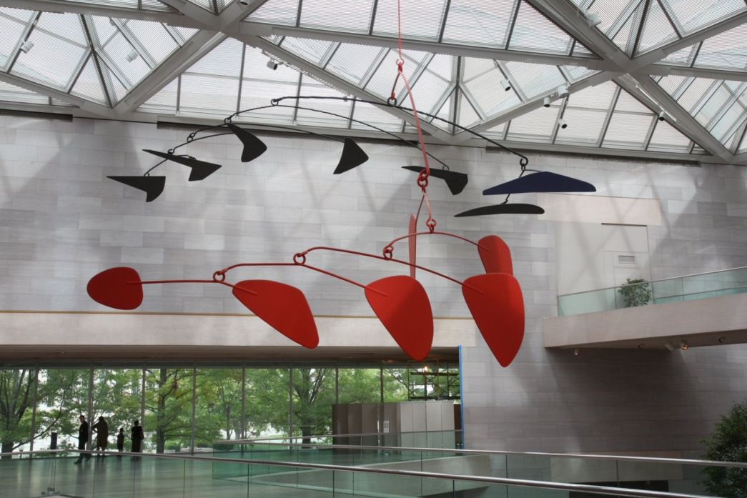
Space in 3D Art
3D works that move are called Kinetic Art
Alexander Calder, Mobiles
Notes:
Alexander Calder created the Mobile in bottom left just before his death in 1976. At first he planned to add small motors to the sculpture so it would move but after measuring the air currents, he found there is enough! It will move!

Slide 14
Space in 3D Public Art
Notes:
1995- truck with explosives blew up the Alfred P. Murrah Federal Building. 168 innocent people, including 19 children in a daycare center, died.
Designing for a memorial carries a lot of weight. The memorial needs to meet the needs of survivors, victim’s families, city planners, local business and the public.

Slide 15
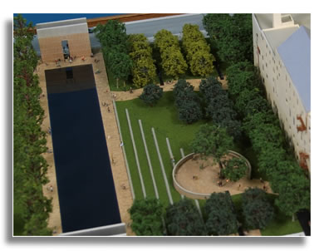
Space in 3D Public Art
Oklahoma City National Memorial, by Butzer Design Partnership.
Notes:
Memorial consists of two gates, one displaying the time 9:01 the moment before the explosion, and the other 9:03 the moment the city was changed forever.

Slide 16
Space in 3D Public Art

Slide 17
Space in 3D Public Art
Notes:
There are 168 empty chairs representing each individual lost. They are arranged in 9 rows representing the 9 floors on which the victims worked or visited

Slide 18
Space in 3D Public Art
Photo by Eric D Brown
Notes:
The memorial wanted to emphasize place, a moment in time, and the passage of time. How have they achieved this goal?
How does the design and use of space help achieve this? Or achieve an emotional response?

Slide 19
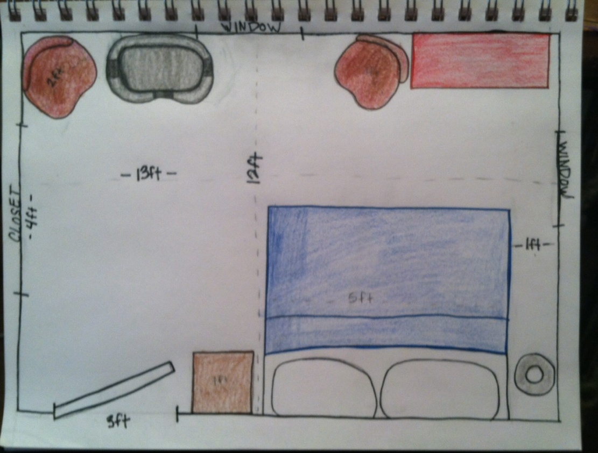
Weekly Sketch
Draw a floor plan of your room (or any room in your house) from memory. Include approximate measurements in your plan.

