Slide 1
Finding the Elements of Art

Slide 2
Line
Follows the contours of the object/subject

Slide 3
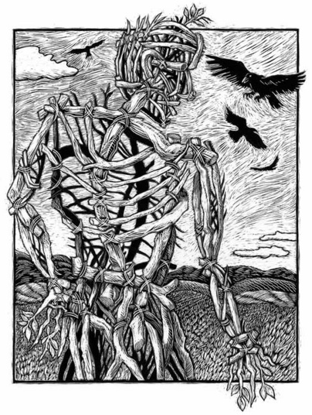
Line
Repeated to create movement or texture

Slide 4
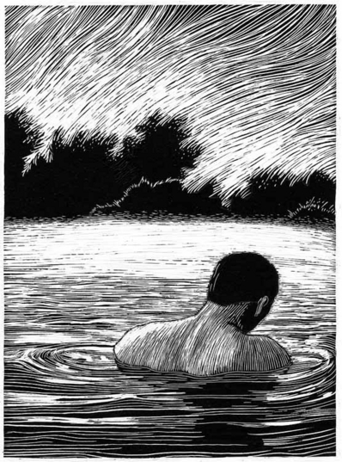
Line
Look closely at the lines in this artwork by Kathleen Edwards.
Use 5-8 complete sentences to describe the lines in this artwork.

Slide 5
Shape and Form
Shape vs. Form
Figure Ground

Slide 6
Open and Closed Shapes
Open Shapes have space around and between them and share some importance with the background
Closed shapes and forms seem solid and heavy

Slide 7
Shape Constancy
The tendency to see a shape as unchanging regardless of the angle at which you see it.

Slide 8
Shape
Look closely at the lines in this artwork by Edward Hopper.
Use 6-10 complete sentences to describe the shapes and lines in this artwork.

Slide 9
Color and Value
Literally translates in Italian to mean “light-dark”
It is Dramatic Contrasts between light and dark.
Light and Darkness are used as symbols in stories and legeneds

Slide 10
Value and Expression
Picasso, Woman in White, 1923
Marie-Denise Villers, Young Woman Drawing, 1801
Notes:
Picasso uses mostly middle range values. Contrast is minimal, entire image has soft light. Her pose and expression is also peaceful and relaxed. Light here is a positive role.
Young Woman drawing uses mostly dark values. Her face is illuminated on one side and the rest is in shadow. The strong contrast creates drama and mood. Maybe more solemn or somber.

Slide 11
Color and Intesity
Intensity (aka Saturation) is the Brightness or Dullness of a color
Bright Dull Bright
High Intensity low Intensity High

Slide 12
Color and Expression
Imagine this painting by Picasso in reds, yellows, or oranges.
Cool colors are likely to have a quieting effect
Notes:
Imagine The Old Guitarist in tones of red yellow or orange. In this instance, the blue tones create a saddened mood, in others it can represent serenity, dignity, loyalty and others.
Studies have shown that Pink has a calming effect on violent children.
In one experiement, factory workers thought that the room temperature had been raised after the colors in the room were changed from blue and gray to red and brown.

Slide 13
Color
Look closely at this image.
Describe the use of color in this image in 5-8 sentences using the following terms: intensity, warm and cool colors, color relationships, and mood/expressiveness.

Slide 14
Space
Notes:
The memorial wanted to emphasize place, a moment in time, and the passage of time. How have they achieved this goal?
How does the design and use of space help achieve this? Or achieve an emotional response?

Slide 16
Space
Notes:
Overlapping
High and Low Placement
Linear Perspective
Aerial Perspective

Slide 17
How is space indicated in this artwork?
Look closely and describe space in this painting in 5-8 sentences.

Slide 18
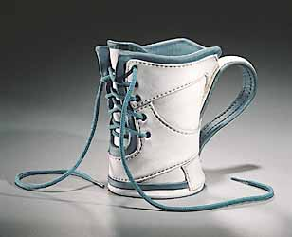
Texture
Simulated vs. Invented Texture
Notes:
Simulated vs. Invented Texture
Should time involved or skill make an artwork more valuable?

Slide 19
Texture
Notes:
Line: Curved line created by dam, some lines created by ersoion on rocks, levels of sediment.
Shape: Main shapes are those created by the two rock formations on each side, the body of water from the bottom right corner to the center of the image, and the trapezoid shape made by the dam in the left upper center. The shapes fill the picture plane leaving a small piece of sky at the top. The body of water acts as an open shape
Space: Space is indicated by the overlapping rock formations. The dam cuts our eyes off from seeing where the two formations meet. There is a third formation in the far distance that is overlapped by the dam and the rock formation on the left. The clouds in the sky show us even more distance and depth.
Value: Strong value contrasts are created by the white clouds, the white cement dam, the white rolling water. These bright highlights contrast with the dark shadows cast by the rock formation on the right. The darkest value is on the edge where the rock meets the water. There is a little bit more high light than very dark shadows. The rest of the image is made of a variety of middle tones. The lighter middle tones fall in the foreground and the top of rock segments near the water.
Texture: Texture here is indicated by values. The rocks have rough surfaces created by flowing water and erosion.

Slide 20
Description
In writing, use Vocabulary to describe this artwork using at least ten complete sentences

