Slide 1
Expressive Line

Slide 2
Lines have Personalities
Shape-
Straight lines remind us of things like buildings that are strong or powerful
Curved lines remind us of people, animals, or plants that are soft, delicate, or graceful
Jagged lines suggest objects like broken glass, saw teeth, or lightning that are aggressive or wild.

Slide 3
Lines have Personalities
Movement
Straight lines seem rigid or swift
Curved lines seem relaxed or graceful
Jagged lines seem nervous or awkward

Slide 4
Lines have Personalities
Direction
Vertical directions seem strong
Horizontal lines seem calm or stable
Diagonal lines seem unstable

Slide 5
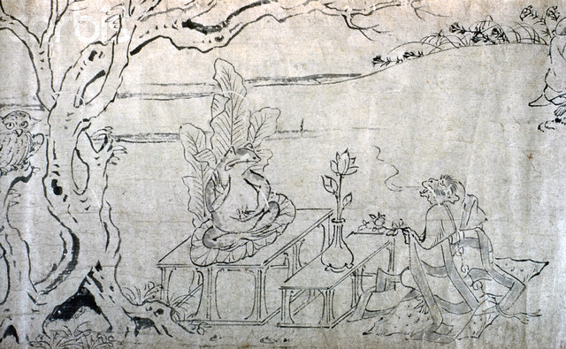
For Centuries, great masters of China and Japan have explored the expressive qualities of line. The brushstroke is the single most important part of their craft.

Slide 6
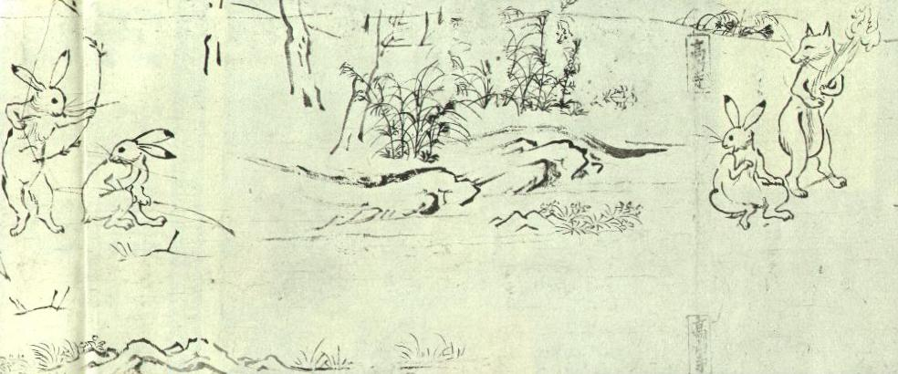

Slide 7
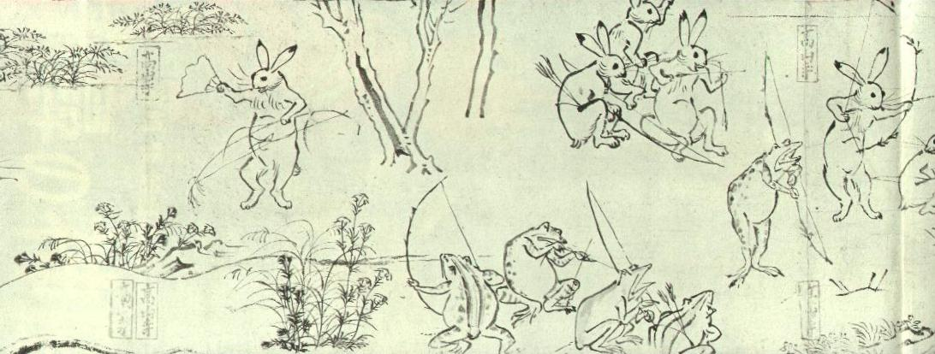

Slide 8
Choju Giga: This has been considered the first Manga (cartoon) in Japan’s art history, supposedly painted by Toba Sojo .
The subject is of frolicking animals engaging in human like behavior.
Only the first chapter, Ko, is thought to be Sojo’s. It is believed that different artists painted other parts of this handscroll at different times.

Slide 9
For Centuries, great masters of China and Japan have explored the expressive qualities of line. The brushstroke is the single most important part of their craft.

Slide 10
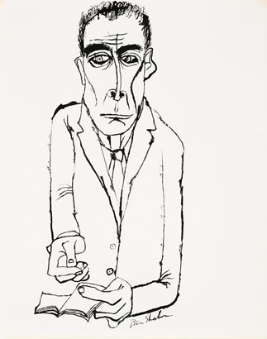
Dr. J. Robert Oppenheimer
By Ben Shahn

Slide 11
The Committee of 100
By Ben Shahn

Slide 12
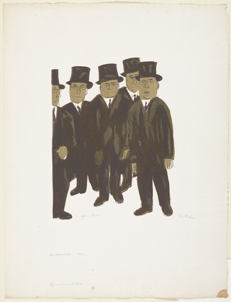
4 ½ Out of Every 5 Think
By Ben Shahn

Slide 13
In what different ways do they distort visual imagery to create drama?

Slide 14
Choose an object

Slide 15
Choose an adjective:
Aggressive delicate, soft, awkward, energetic, strong, balanced, explosive, swift, blunt, graceful, timid, bristling, nervous, unstable, brutal powerful, weak calm, restless, wild, chaotic, rhythmic.

Slide 16
Draw your object using a line that expresses the adjective you have chosen

