Slide 1
Color and Value
Art 3 & 4

Slide 2
Color and Value
Each are only visible because of light.
Light and Darkness are used in legends of most cultures
Ted Video

Slide 3
Color and Value
Light symbolizes truth, hope, and new life.
Darkness symbolizes evil, fear of the unknown, and death

Slide 4
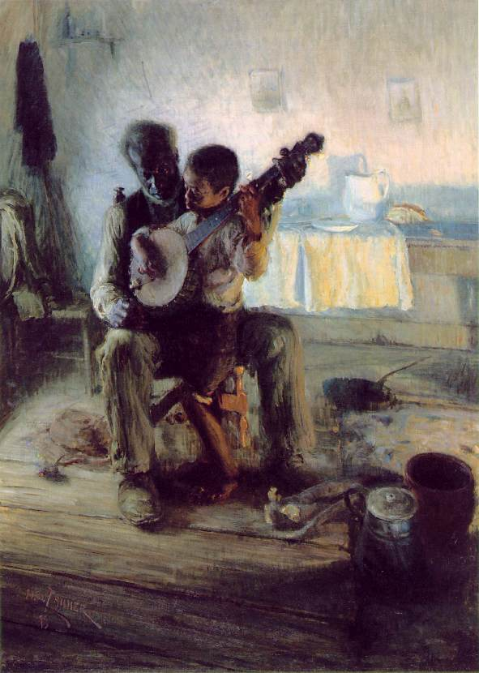
Value
Lightness and Darkness are Relative depending on its surroundings
Notes:
Compare the Banjo face to the shadows around it. Is it light or dark comparatively?
Now compare it to the back wall? Value is relative to its surroundings.

Slide 5
Chiaroscuro
Literally translates in Italian to mean “light-dark”
It is Dramatic Contrasts between light and dark.
Caravaggio, The Supper at Emmaus
Notes:
Before Electric lighting, artists who worked after sundown used candles. These works fostered the popularity of Chiaroscuro which is created from 1 source, usually a candle

Slide 6
Value and Expression
Picasso, Woman in White, 1923
Marie-Denise Villers, Young Woman Drawing, 1801
Notes:
Picasso uses mostly middle range values. Contrast is minimal, entire image has soft light. Her pose and expression is also peaceful and relaxed. Light here is a positive role.
Young Woman drawing uses mostly dark values. Her face is illuminated on one side and the rest is in shadow. The strong contrast creates drama and mood. Maybe more solemn or somber.

Slide 7
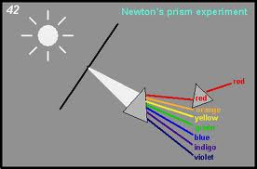
Color
Isaac Newton determined Color comes from Light
Rays from the sun were divided into colors we know today

Slide 8
Color
The 7 rays are known as the Spectrum
The colors we see are actually the rays that are reflected by the object, the rest are absorbed.
Notes:
Different surfaces absorb different rays

Slide 9
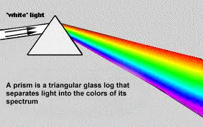
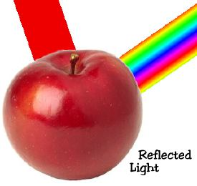
Color and Light
Light travels with entire spectrum of colors which appears white until it meets an object and some colors are absorbed and others are reflected.

Slide 10
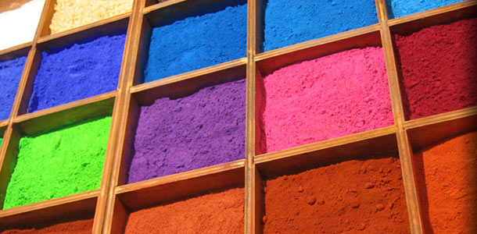
Color and Pigment
Is made from using surfaces that reflect certain light rays

Slide 11
Color and HUE
Hue identifies a color as blue, yellow, red, green, or another color from the Color Spectrum

Slide 12
Color and Intesity
Intensity (aka Saturation) is the Brightness or Dullness of a color
Bright Dull Bright
High Intensity low Intensity High

Slide 13
Color and Intesity
Mix and colors next to one another will create another BRIGHT color
Mix Compliments will give you a duller color

Slide 14
Color Interactions
Colors are affected by each other and appear differently based on their context

Slide 15
Color Interactions
Which smaller square appears more orange?

Slide 16
Color Interactions
Hue Interactions: colors will appear differently when placed next to one another

Slide 17
Color Interactions
Which Pink appears darker?

Slide 18
Color Interactions
Value Interactions: a lighter color appears darker on a lighter background.

Slide 19
Color Interactions
Which appears of the smaller squares appears brighter?

Slide 20
Color Interactions
Intensity Interactions: a color will appear brighter on top or near a duller color

Slide 21
Henry Matisse
Compliments provide the most Contrast
Split Compliments take some of the harshness away.
What other compliment pairing can you find besides Red and Green?

Slide 22
Optical Illusions and How We See
Beau Lotto is founder of Lottolab, a hybrid art studio and science lab.
For more visit Lottolab.org

Slide 23
Henry Ossawa Tanner
1859-1937
At age 13, decided he wanted to be an artist but not an ordinary artist
Studied at Academy of Fine Arts in Pennsyl.
Moved and lived in Paris, France

Slide 24
Henry O Tanner
Find examples of tints, shades, bright and dull colors, primary and secondary, warm and cool colors.

Slide 25
Henry O Tanner
What objects do you see?
What do they tell us about the setting?
Where is the light source?
What might it be?

Slide 26
Henry Ossawa Tanner
This painting was created less that 30 years after the Civil War ended.
What important messages about post-war African American life does it convey?

Slide 27
Weekly Sketch
Create an abstract drawing using organic and/or geometric shapes
Use colored pencils to color your image using an example of one or all Color Interactions: Hue, Value, or Intensity Interaction

