Slide 1
Color and Value
Art 1 & 2

Slide 2
Color and Value
Each are only visible because of light.
Light and Darkness are used in legends of most cultures
Notes:
Can you think of a contemporary film that uses light and dark as symbols?

Slide 3
Color and Value
Light symbolizes truth, hope, and new life.
Darkness symbolizes evil, fear of the unknown, and death

Slide 4
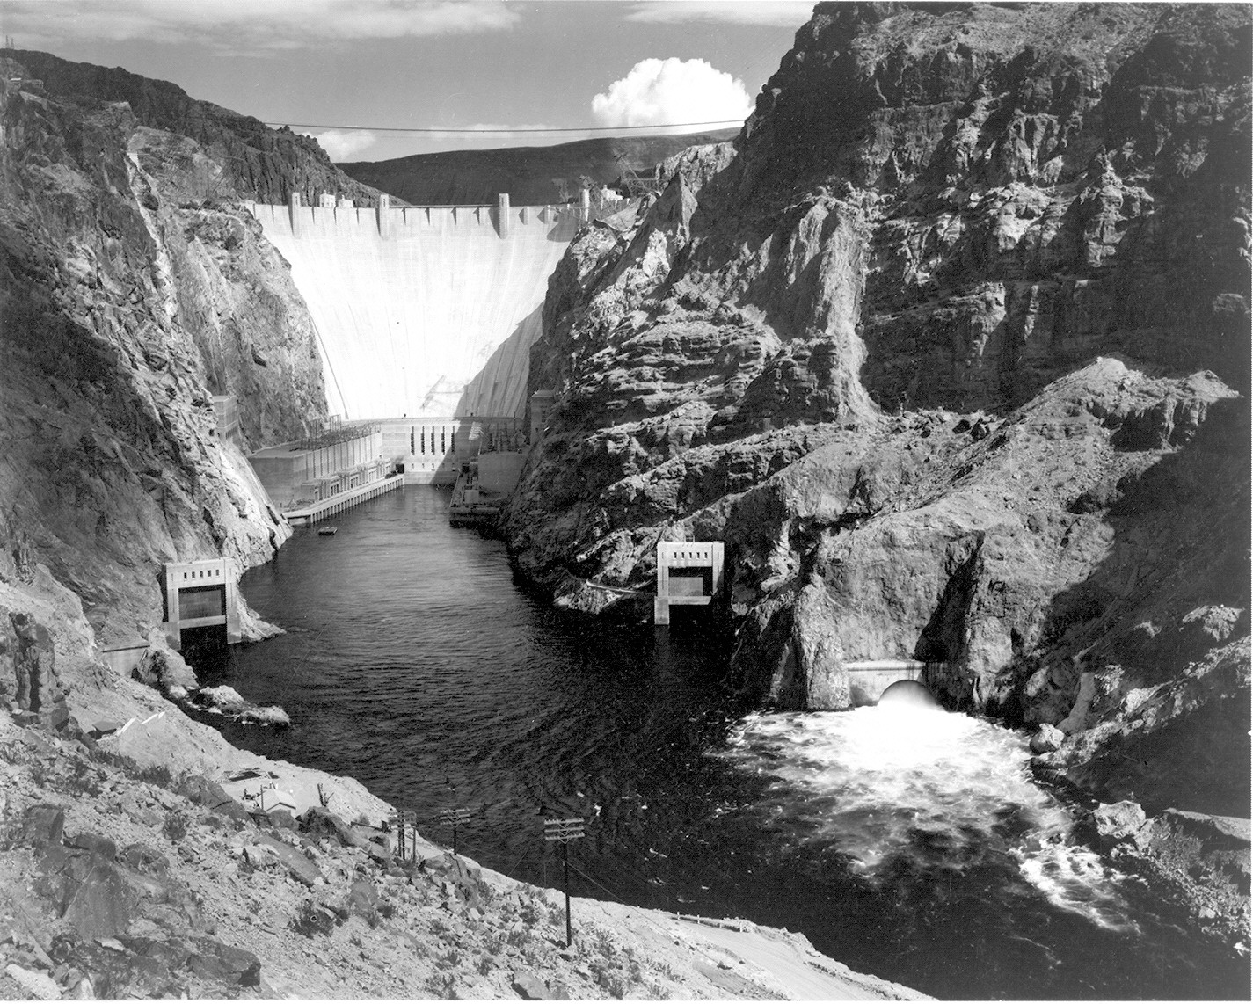
Value
Value= the range light and dark
9 step scale
Notes:
Ansel Adams is a well known photographer we will look at further tomorrow. His work in Photography made a lasting impact- He developed a system to capture the brightest highlights and darkest shadows in one photograph.

Slide 5
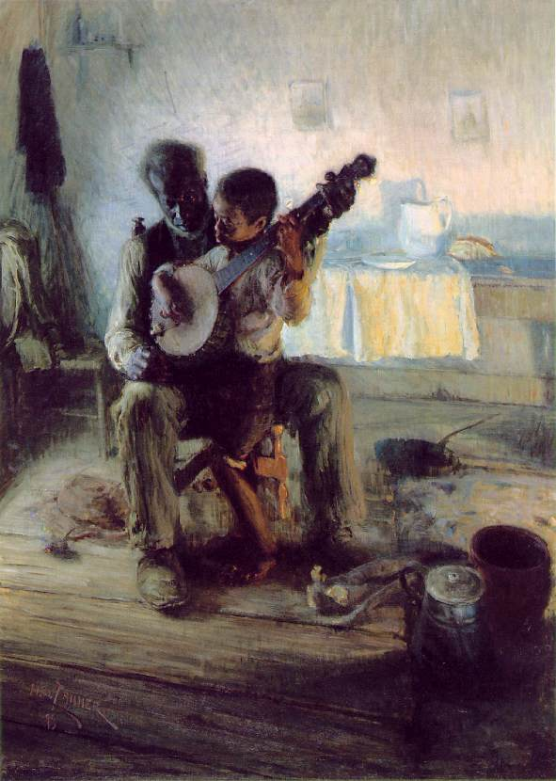
Value
Lightness and Darkness are Relative depending on its surroundings
Notes:
Compare the Banjo face to the shadows around it. Is it light or dark comparatively?
Now compare it to the back wall? Value is relative to its surroundings.

Slide 6
Reflected Light
How much light is being reflected gives us dark and light values on an object
Using multiple values makes an object look solid.
Notes:
Reflected light is going to be very important when we talk about color as well.

Slide 7
Chiaroscuro
Literally translates in Italian to mean “light-dark”
It is Dramatic Contrasts between light and dark.
Caravaggio, The Supper at Emmaus
Notes:
Before Electric lighting, artists who worked after sundown used candles. These works fostered the popularity of Chiaroscuro which is created from 1 source, usually a candle

Slide 8
Value and Expression
Picasso, Woman in White, 1923
Marie-Denise Villers, Young Woman Drawing, 1801
Notes:
Picasso uses mostly middle range values. Contrast is minimal, entire image has soft light. Her pose and expression is also peaceful and relaxed. Light here is a positive role.
Young Woman drawing uses mostly dark values. Her face is illuminated on one side and the rest is in shadow. The strong contrast creates drama and mood. Maybe more solemn or somber.

Slide 9
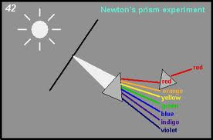
Color
Isaac Newton determined Color comes from Light
Rays from the sun were divided into colors we know today

Slide 10
Color
The 7 rays are known as the Spectrum
The colors we see are actually the rays that are reflected by the object, the rest are absorbed.
Notes:
Different surfaces absorb different rays

Slide 11
Color and HUE
Hue identifies a color as blue, yellow, red, green, or another color from the Color Spectrum

Slide 12
Color and White Light
Combining all hue colored lights together is an additive process
Mixing all results in white light

Slide 13
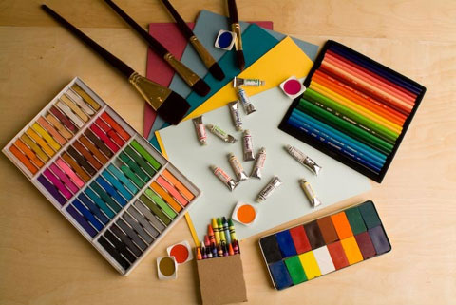
Color and Pigment
Pigments behave the same as surfaces- they are a color because that is the ray they reflect

Slide 14
Color and Pigment
Combining pigments together) is a subtractive process
Mixing the primary colors in correct proportion will result in black.

Slide 15
Color Schemes Quiz ☺
Primary
Secondary
Tertiary
Monochromatic
Tints
Shades
A
B
C
D
E
F

Slide 16
Color Schemes Quiz ☺
Primary C
Secondary A
Monochromatic B
Tertiary E
Tints D
Shades F
A
B
C
D
E
F

Slide 17
Neutrals
Neutrals are shades of gray
Black, White and Gray have no identifiable Hues
Neutrals are created by mixing varying amounts of black and white and also Complimentary Colors

Slide 18
Henry Matisse
Compliments provide the most Contrast
Split Compliments take some of the harshness away.
What other compliment pairing can you find besides Red and Green?

Slide 19
Color and Intesity
Intensity (aka Saturation) is the Brightness or Dullness of a color
Bright Dull Bright
High Intensity low Intensity High

Slide 20
Color and Intesity
Mix and colors next to one another will create another BRIGHT color
Mix Compliments will give you a duller color

Slide 21
Color and Expression
Imagine this painting by Picasso in reds, yellows, or oranges.
Cool colors are likely to have a quieting effect
Notes:
Imagine The Old Guitarist in tones of red yellow or orange. In this instance, the blue tones create a saddened mood, in others it can represent serenity, dignity, loyalty and others.
Studies have shown that Pink has a calming effect on violent children.
In one experiement, factory workers thought that the room temperature had been raised after the colors in the room were changed from blue and gray to red and brown.

Slide 22
Color and Expression
Warm colors are likely to excite us
Van Gogh used color to describe his pains and anguish but he also used it in more peaceful ways.

Slide 23
Color in Culture
Some cultures only have terms for light, dark and red
While others are very attuned to the entire spectrum…

Slide 24
Color in Molas
Molas are made by Kuna peoples.
Used as decorative wall hangings or embellishments on clothing
They have been produced for over 100 years

Slide 25
Color in Molas
Kunas inhabit San Blas Islands

Slide 26
Color in Molas
Molas are created with a technique called Applique
What do you notice about the subject and motifs?

Slide 27
Color in Molas
Use vocabulary terms to describe the colors in this Mola

Slide 28
Color in Molas
Mola is the Kuna word for Clothing
How can a unique art form such as this help foster a sense of cultural identity?

Slide 29
Weekly Sketch
Create a drawing of an object that represents our culture
Use color (split compliment) and value expressively to complete the drawing
Consider the patterns used by the Kuna Culture. What patterns are unique to you?

